Slide 1

Annual General Meeting for 2022
President’s Report
Sanya M. Goffe
Delivered December 20, 2023

Slide 2

2023 Highlights:
Continued advocacy of Automatic Enrolment proposal (IDB + widescale industry endorsement).
Conducted 3 Data Protection Workshops.
Held 2 Quarterly meetings with FSC.
Hosted Annual Luncheon – IDB – Designing a Multi Pillar Pension System for a high informality environment.
Participated in Stakeholder Consultations with BoJ + FSC on Twin Peaks Supervisory Model.
Guest Speaker at Caribbean Association of Pension Supervisors Conference.
Meeting with Minister of Labour.

Slide 3
2023 Highlights Cont’d:
Participated in FSC + BHC’s Webinar on Fintech & Artificial Intelligence in Pension Industry.
Met with FSC to discuss implications of cyber attack.
Interview on Caribbean Business Exchange – broadcast throughout Caribbean.
Interview on ‘Get the Facts’ on Jamaica Information Service.
Engaged in several other interviews – tv, radio and social media.
Regular newsletter and email updates to members.
Submission to OIC on Data Protection Act.
Continued to advocate on removal of maximum pension limits.
Refreshed website.

Slide 5


Slide 7
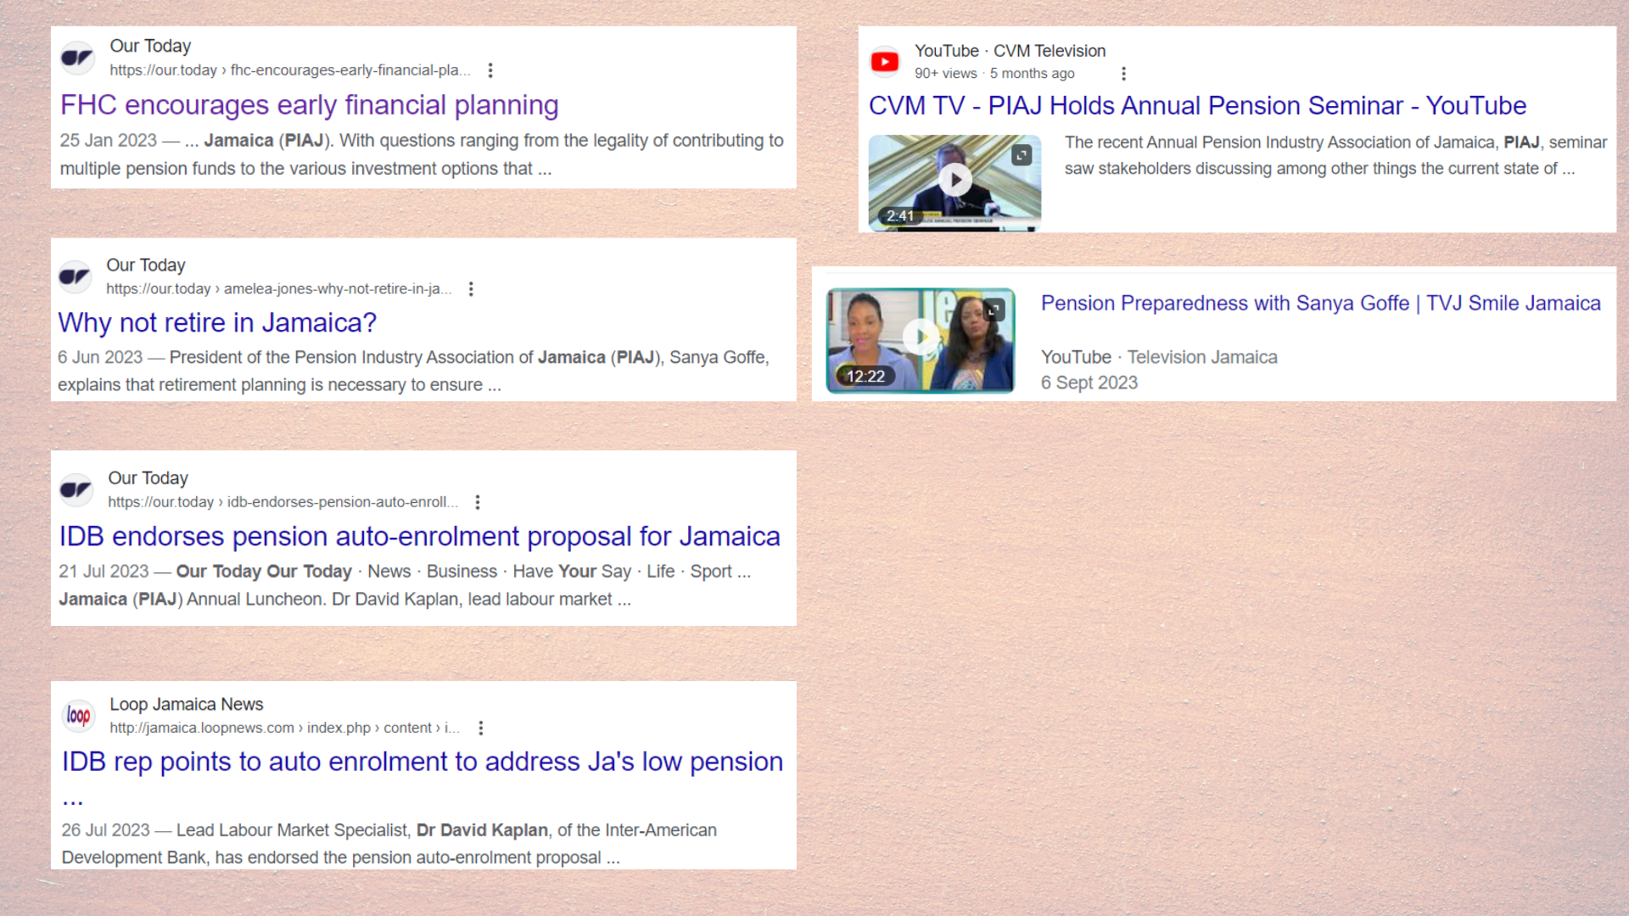

Slide 8
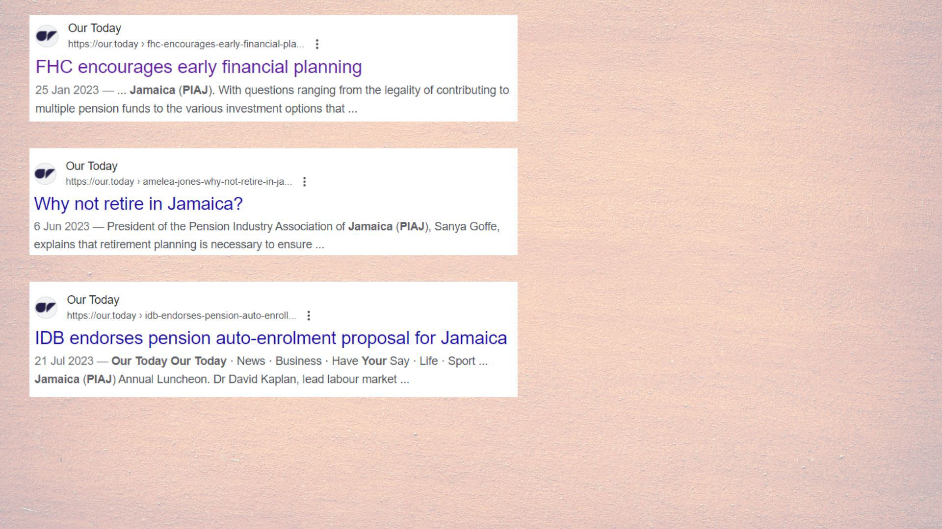
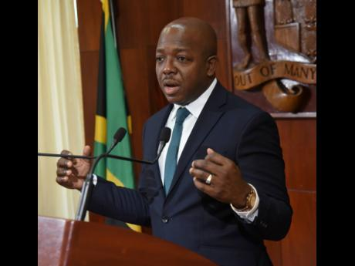
The Gleaner Thursday June 22, 2023
Editorial | Mr Charles’ pension task
“… Among the proposed solutions is one from the Pensions Industry Association of Jamaica (PIAJ) that all employed persons, who are not already part of pension plans, be automatically enrolled in an approved retirement scheme. While it would not be mandatory that they stay, judging from jurisdictions where this approach has been used, the PIAJ believed that most would remain in the schemes.”

Slide 9



Followers
Instagram 1,663 followers (up from 539)
Facebook 1,965 (up fr 599)
X (formerly Twitter) 560 followers (up fr 520)
Reach
Instagram – 73,348
Facebook – 68,731
X (Twitter) – 27,100
AD TRENDS:

Slide 10
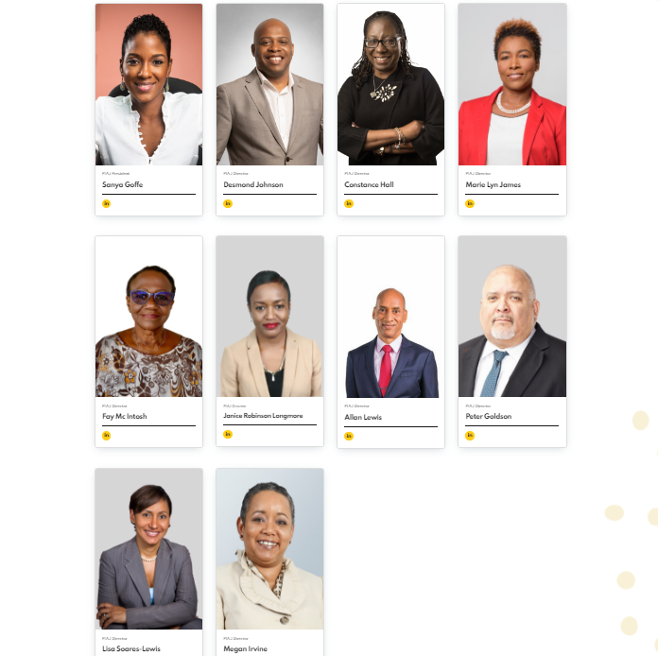
Our Team
Board members continue to give of their time, talent and energy on a voluntary basis to strengthen the PIAJ and improve the Association’s contribution to the pension sector.

Slide 11
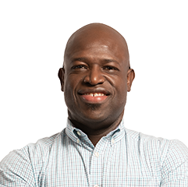
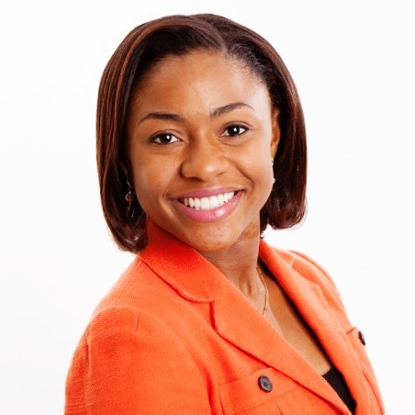
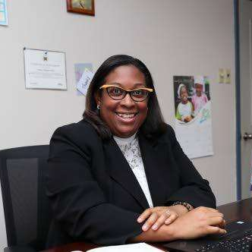
New Directors
Kerri-Ann T. Allen Morgan – Attorney-at-Law & Partner, Livingston Alexander & Levy.
Antonio Spence - Senior Assistant General Manager at NCB Insurance Agency and Fund Managers.
Latoya Mathew-Kerr - General Manager of Sagicor Employee Benefits Administrators Limited, Pension Services.

Slide 12
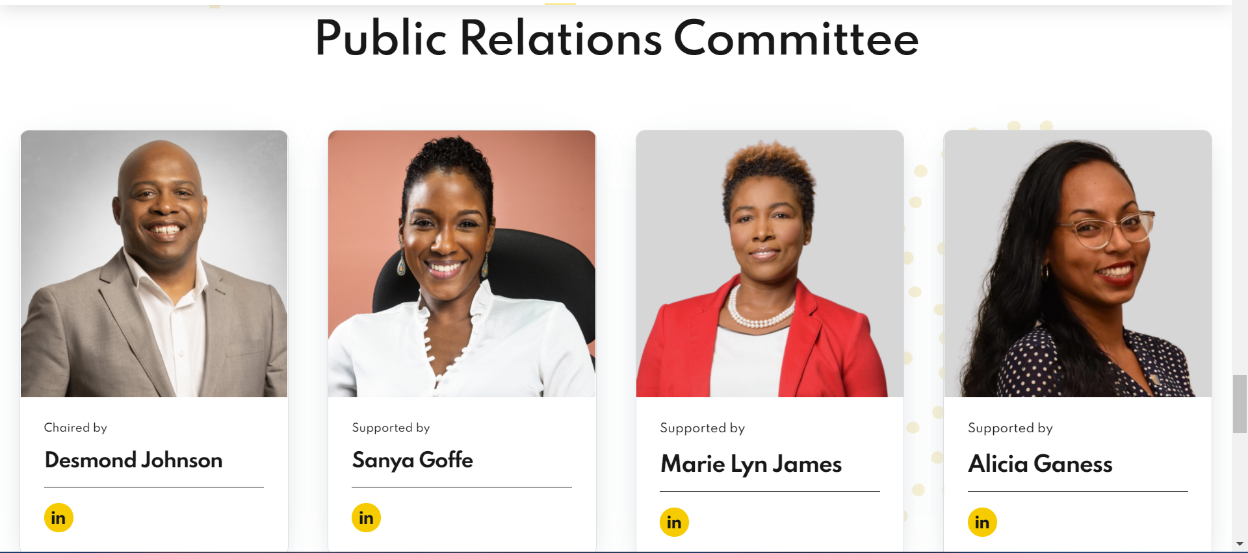
Our Team
The Public Relations Committee has put in hours of work meeting every two weeks to ensure that our communication and public education objectives are met.

Slide 13
PIAJ COMMITTEES
Public Relations
Legislative & Governance
Membership
Finance

Slide 14
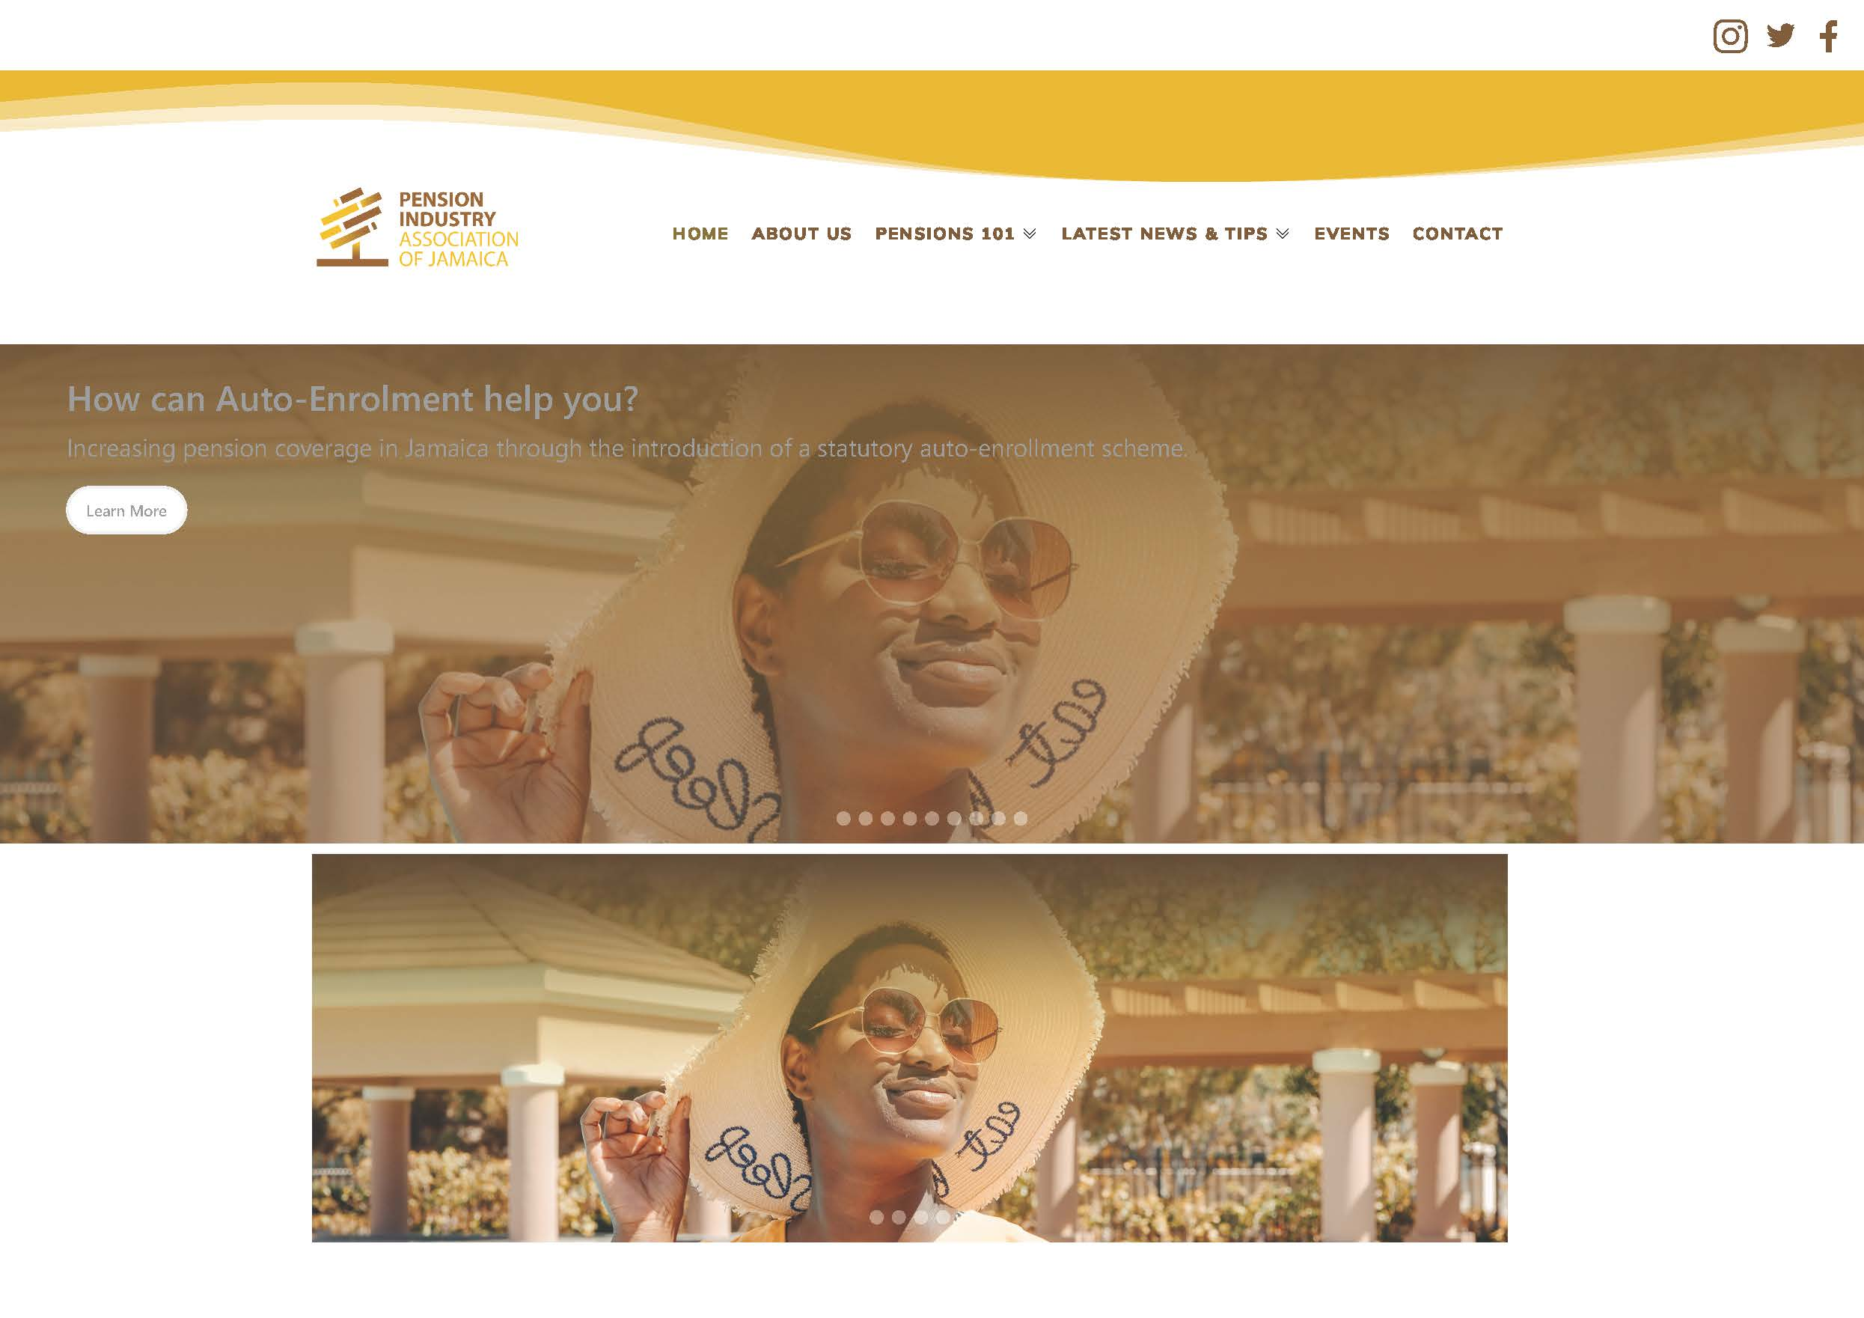
Continue to check our website for news and updates.

Slide 15

Thank you very much for attending.
We look forward to your on-going feedback and
participation in industry developments in the coming year.
  Sanya Goffe
  President
  December 20, 2023

